Slide 1
Data Viz II
Sean McMinn

Slide 2
Choosing types of charts - Alberto Cairo
https://youtu.be/CdRQ7LDiqLs?t=2606

Slide 3
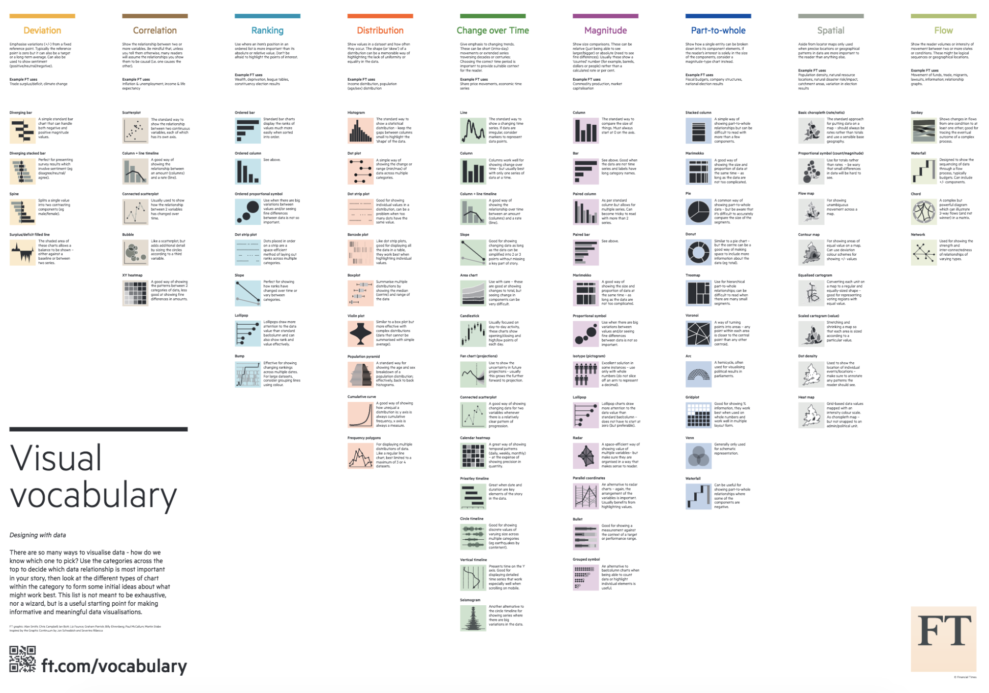
When to Use Different Charts
Easiest answer: print this out
https://github.com/ft-interactive/chart-doctor/blob/master/visual-vocabulary/Visual-vocabulary.pdf

Slide 4
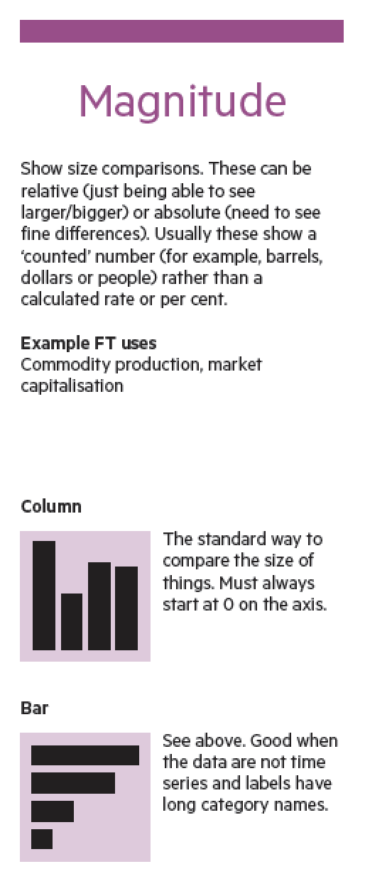
When to Use Different Charts

Slide 5
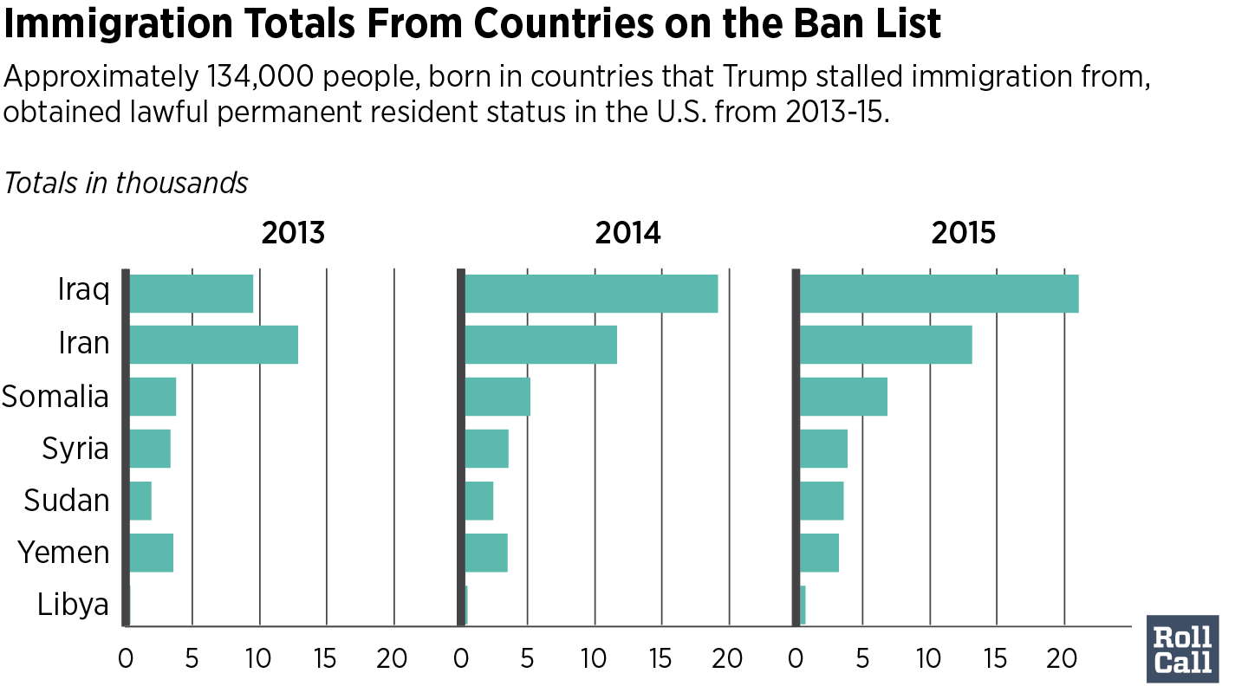
When to Use Different Charts

Slide 6
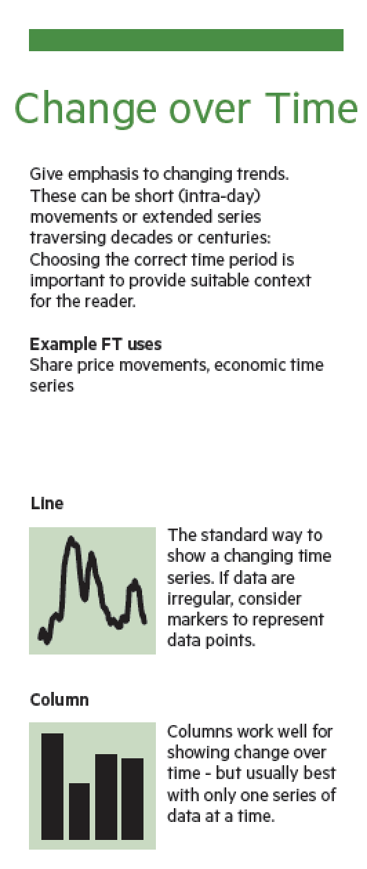
When to Use Different Charts

Slide 7
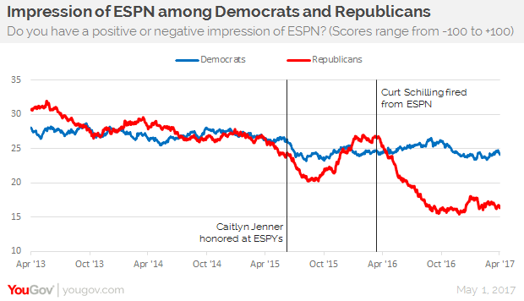
When to Use Different Charts

Slide 8
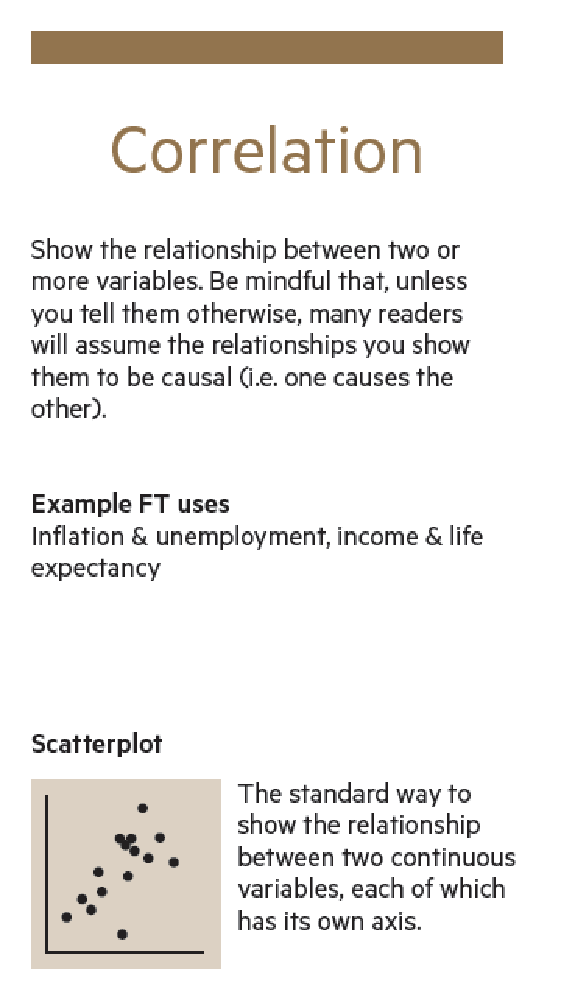
When to Use Different Charts

Slide 9
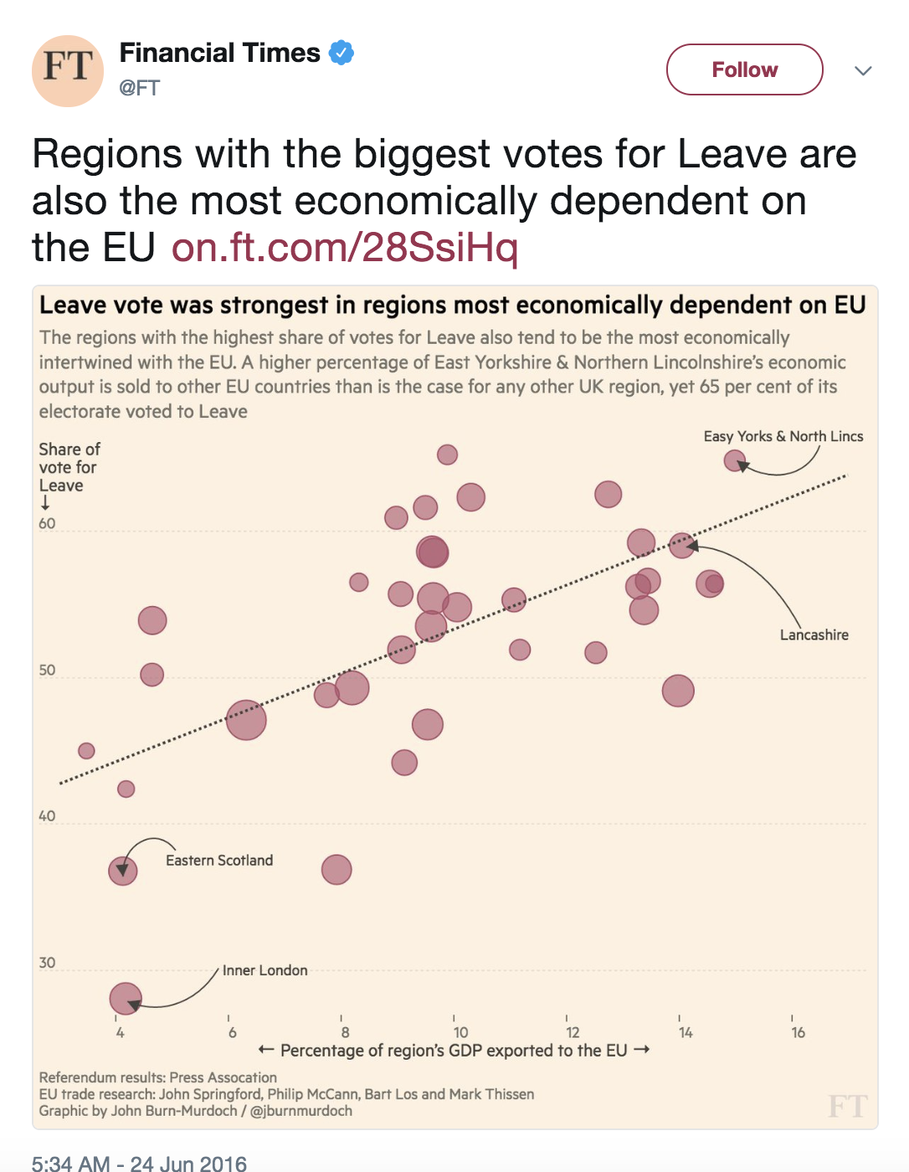
When to Use Different Charts

Slide 10
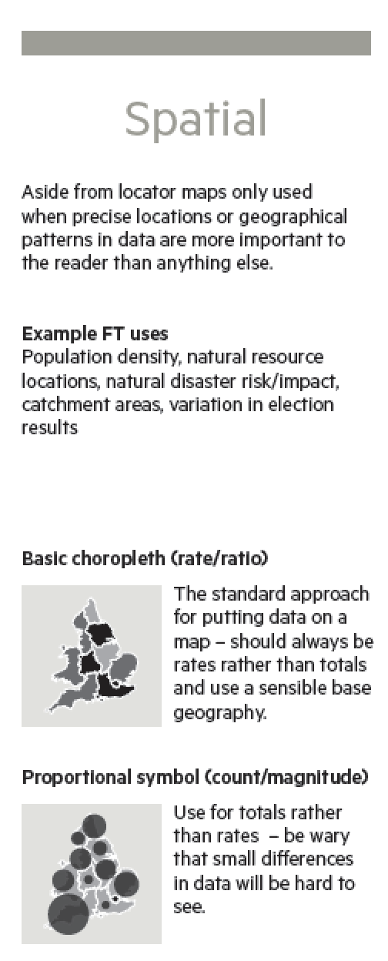
When to Use Different Charts

Slide 11
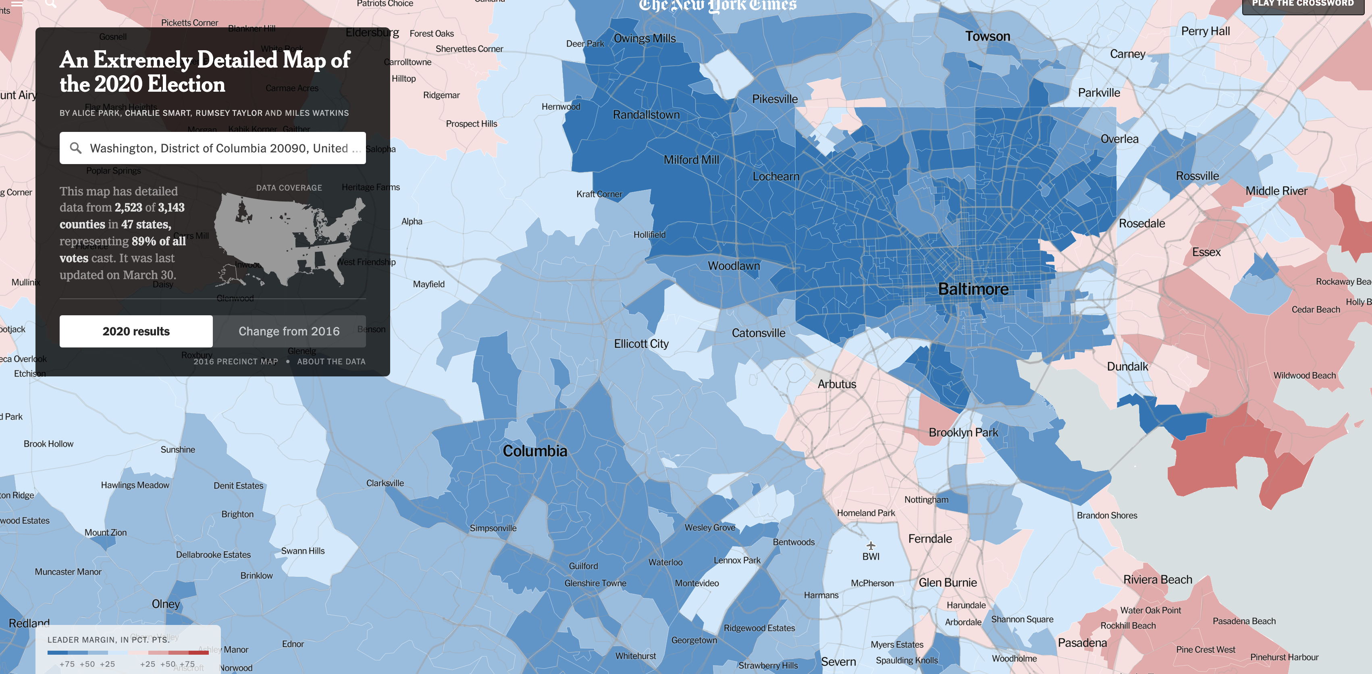
When to Use Different Charts

Slide 12
“What tool do you use?”
Most common question I get
IMO, not nearly the most important

Slide 13
“What tool do you use?”
People, I think, ask this question because they think that if they could just learn “X” tool, they too will be able to make data visualizations
This is technically true – but for all the reasons we talked about in the first half of this course, it takes a lot more than that

Slide 14





“What tool do you use?”
That being said… here’s what I use.
matplotlib
Daily Graphics (NPR)
D3.js
Tableau Public
Adobe Illustrator

Slide 15


“What tool do you use?”
Here’s what’s not quite as good
Excel
Infogram

Slide 16

Difficulty

Slide 17
Difficulty
These two have the biggest payoff for the learning curve, so we’re going to tackle them today.

Slide 18
Datawrapper classroom survey
Tableau dataset exploration/visualizations
Take a Tableau finding and make a DW chart

